Slide 1
Queues and message based architecture

Slide 2
What is a queue?
Infinite loaf of bread
Maybe an infinite bread bin with a finite amount of bread

Slide 3
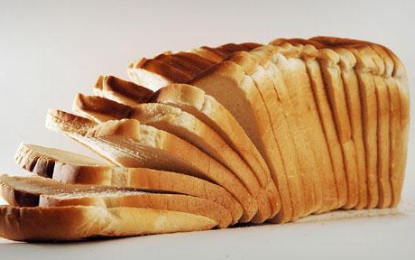
Bread?
Make bread
Eat bread

Slide 4
Oh bread.
Each slice of bread is a slice of data

Slide 5
I don’t have any bread
Okay, so put some other things in the queue
Tasks
Messages

Slide 6
Messages
CreateUser
ID
First Name
Last Name
Email Address
Phone Number
….

Slide 7
In process queues
Let’s look at some code
Things to look out for
Producers
Consumers
Blocking vs. non-blocking queue

Slide 8
Out of process queues
There are a million queues out there
MSMQ
RabbitMQ
ZeroMQ
WebSphere MQ

Slide 9
Cloud queues
Azure Queues
Amazon Simple Queue Service

Slide 10
Properties of queues
Durability
Speed
Reliability

Slide 11
Durability
Messages are written to persistent store
Recoverable in the event of power outage

Slide 12
Reliability
Messages are delivered at least once
In many queues messages can be delivered more than once
Distributed transaction support

Slide 13
Speed
Thousands of messages a second can be processed
Doesn’t encounter the trashing issues common with web services

Slide 14
Scalability vs. Web services
Requests Served
Incoming Requests

Slide 15
Building your application with messages
Subscriber
Subscriber
Subscriber
Publisher

Slide 16
Building your application with messages
Creates a well defined API
Promotes low coupling
Easy to scale
Easy to swap components
Creates great extensibility points

